Slide 1
Fractions Doodle Notes
Let’s have fun
Notes:
Start at the beginning: 1. Practice with Doodle Notes – learn to take notes keeping the creative part of brain open to improve retention and to create usable reference 2. Introduce concept of charters as mnemonic device 3. Introduce precise language based on current standards 4. Catch any misconceptions and mistakes

Slide 2
Equal Shares
Fractions – part of the whole
Parts must all be the same size – equal shares
Share it equally, Baby.
Make 6 equal shares
Make 4 equal shares
Make 3 equal shares
Notes:
IXL Grade 3 W1
Lessons – creating equal shares requires higher level skills and understanding of fractions. Kids should just estimate at first then you can circle back and have the students use what they learned about fractions to create better estimates for equal shares
using a clock face to estimate equal shares; using a compass or ruler to create equal shares

Slide 3
Fractions – part of the whole
Parts must all be the same size – equal shares
Unequal are Terminated.
Cross out the shapes with unequal shares.
Notes:
IXL Grade 3 W1

Slide 4
Parts of Fractions
Numerator the Nutcracker
Chooses specific parts
division bar
Denominator the Dwarf
Chops up/segments the whole
Into equal parts
Creates groups
4
-
5
Numerator the Nutcracker
division bar
Denominator the Dwarf

Slide 5
Same Size
Fractions – part of the whole
Parts must all be the same size – equal shares
Choose wisely you must.
Choose 5.
$$\frac{5}{8}$$
$$\frac{2}{3}$$
Choose 2
Choose 1
$$\frac{3}{4}$$
$$\frac{1}{2}$$
Choose 3
$$\frac{5}{12}$$
Choose 2
$$\frac{2}{4}$$
Choose 5.
Choose 7
$$\frac{2}{9}$$
Notes:
IXL Grade 3 W4-5

Slide 6
Numerator/denominator
Fractions – part of the whole
Numerator – how many you chose
How many shares you chose
Parts we have
Numerator
Division bar or fraction bar
Denominator
Denominator – how many equal shares
Total parts
Named with ordinal numbers
Ordinal Numbers – half, third, forth or quarter, fifth… show order
List 5 more ordinal numbers __________________
__________________________________________
Cardinal Numbers – 1, 2, three, forty-nine… show quantity
Notes:
IXL Grade 3 A6

Slide 7
Naming Fractions
Naming Fractions
Say the numerator then the denominator
Write the numerator above the fraction bar then the denominator value below
one
$$\frac{1}{2}$$
half
3 Chosen
4 equal
shares
$$\frac{3}{4}$$
three
fourths
one
$$\frac{1}{8}$$
eighth
Notes:
IXL Grade 3 W3-8

Slide 8
Color Fractional Parts
Fractions – part of the whole
Color in the fractional parts.
$$\frac{2}{3}$$
$$\frac{5}{8}$$
$$\frac{5}{9}$$
$$\frac{1}{2}$$
Create equal parts then color in the fractional parts.
$$\frac{3}{4}$$
$$\frac{3}{5}$$
$$\frac{1}{3}$$
$$\frac{5}{8}$$
$$\frac{1}{2}$$
Notes:
IXL Grade 3 W3-8

Slide 9
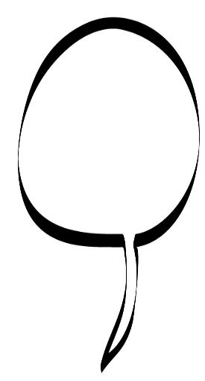
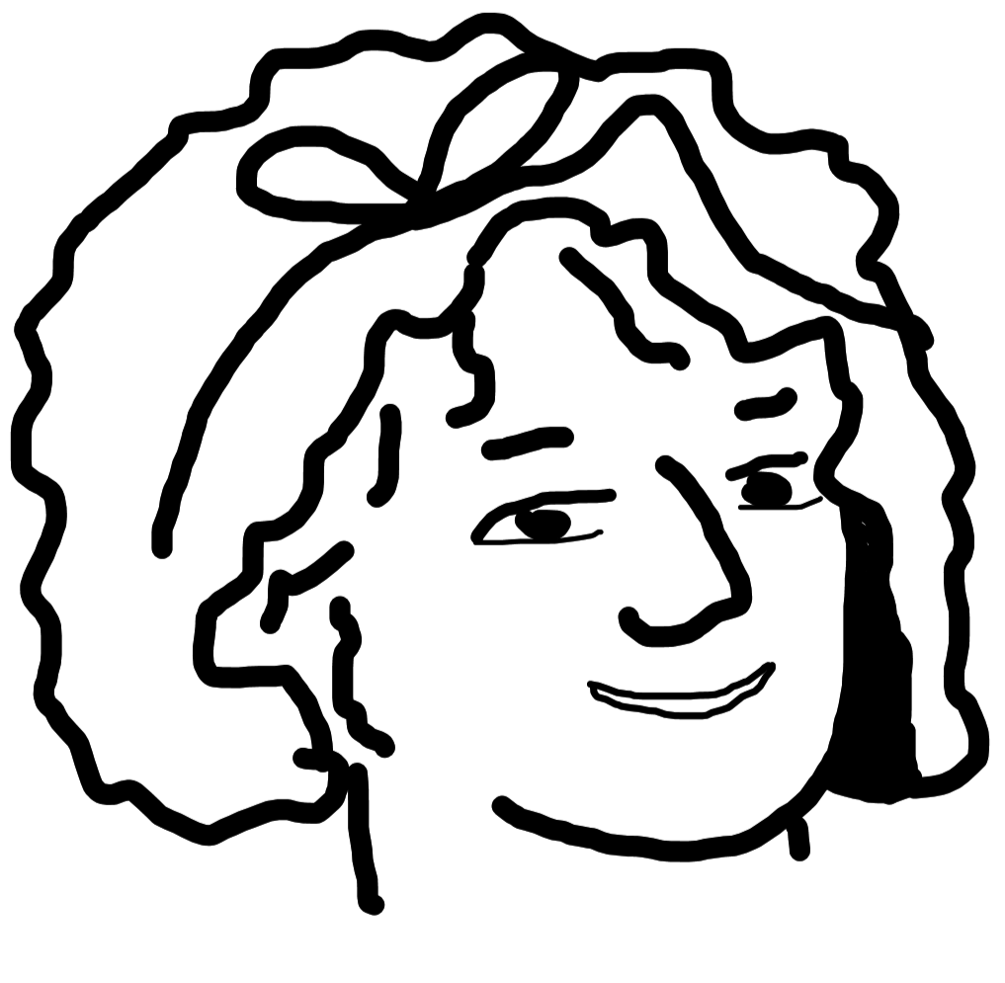
Fraction of whole
Fractions of the Whole
When you have all the parts of the whole
Whole Cookie!
$$\frac{1}{2}$$
$$\frac{1}{2}$$
1
$$\frac{2}{2}$$
$$\frac{1}{2}$$
= 1
2 s make 1 whole
$$\frac{1}{3}$$
$$\frac{1}{3}$$
$$\frac{1}{3}$$
$$\frac{3}{3}$$
= 1
$$\frac{1}{3}$$
Make the whole.
3 s make 1 whole
How many fourths?
Rule
____ fourths equals 1 whole
= 1
How many sixths?
How many twelfths?
How many “n”ths?
There are ____ “n”ths in a whole
Whole Cookie!
$$\frac{2}{2}$$
1 = = = = = = =
Notes:
IXL Grade 3 W16-17
Betsy Ross cut fabric into pieces then sewed them into a pattern so she represents patterns and parts.

Slide 10
Fractions of the Whole
How many “n”ths are needed to make the whole?
1 half plus 1 half equals the whole.
___ twelfths plus ____ twelfths equals the whole.
$$\frac{1}{2}$$
$$\frac{1}{2}$$
$$\frac{1}{2}$$
$$\frac{2}{2}$$
+ = = 1
$$\frac{}{12}$$
$$\frac{}{12}$$
+ = = 1
$$\frac{1}{2}$$
Whole Cookie!
+ = = 1
3 fourths plus 1 fourth equals the whole.
3 + 1
$$\frac{3}{4}$$
$$\frac{1}{4}$$
$$\frac{4}{4}$$
+ = = 1
= 4
+ = =
1 =
$$\frac{8}{8}$$
8
- 1 = 7
$$\frac{8}{8}$$
$$\frac{1}{8}$$
$$\frac{7}{8}$$
$$\frac{1}{8}$$
$$\frac{7}{8}$$
$$\frac{8}{8}$$
+ = =
- =
+ = = 1
1 - =
$$\frac{7}{8}$$
$$\frac{1}{8}$$
Notes:
IXL Grade 4 P2

Slide 11
Fractions of whole numbers
Fractional Versions of Whole Numbers
More Cookies!
1 + 1 = 2
How many equal shares are there when multiple wholes are portioned into the given number of shares?
$$\frac{1}{2}$$
$$\frac{1}{2}$$
2+2=4
$$\frac{2}{2}$$
$$\frac{2}{2}$$
$$\frac{1}{2}$$
$$\frac{1}{2}$$
halves
$$\frac{2}{2}$$
$$\frac{2}{2}$$
$$\frac{4}{2}$$
$$\frac{3}{3}$$
+ + + = = __
+ = = 2
___ wholes portioned into ___ equal shares give ____ equal shares.
2 groups of 2 halves equal 4 halves.
2 x =
$$\frac{2}{2}$$
$$\frac{4}{2}$$
Portion into fourths.
= = __
1 + 1 + 1 = 3
___ wholes portioned into ___ equal shares give ____ equal shares.
$$\frac{12}{12}$$
$$\frac{12}{12}$$
$$\frac{12}{12}$$
$$\frac{36}{12}$$
+ + = = 3
3 wholes cut (portioned) into 12 equal shares give 36 equal shares.
3 groups of 12 twelfths equals 36 twelfths.
= = __
$$\frac{12}{12}$$
3 x =
$$\frac{36}{12}$$
__________________________________________________________________________________________
Notes:
Einstein will fade to laughing Einstein if you click on him

Slide 12
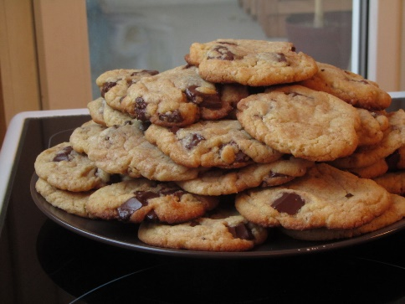
Fractions of whole numbers
Fractions of Whole Numbers
Share Cookies!
3 friends want to share a dozen cookies equally. When they share the cookies equally, each person will get 1/3 of the cookies.
How many cookies did each person get? ______
So 1/3 of 12 is ______.
If we share the cookies with four people, how many cookies does each person get?
So 1/4 of 12 is ______.
What is the pattern?
This Photo by Unknown Author is licensed under CC BY-NC-SA
This Photo by Unknown Author is licensed under CC BY-SA
This Photo by Unknown Author is licensed under CC BY-NC-ND
Notes:
Einstein will fade to laughing Einstein if you click on him

Slide 13
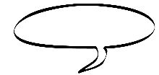
Mixed Numbers / Improper fractions
Mixed Numbers
Mixed numbers - Yummy cookies and crumbs
Whole cookie + ½ cookie
1 and ½ cookies
________________________________________________
Improper
fractions
$$\frac{1}{2}$$
$$\frac{1}{2}$$
Improper – I’m not the greatest.
1 + = 1
2 + 1 = 3
$$\frac{1}{2}$$
$$\frac{2}{2}$$
$$\frac{1}{2}$$
$$\frac{1}{2}$$
$$\frac{1}{2}$$
________________________________________________
halves
$$\frac{2}{2}$$
$$\frac{1}{2}$$
$$\frac{3}{2}$$
$$\frac{1}{2}$$
+ = = 1
$$\frac{1}{12}$$
$$\frac{8}{3}$$
=
1 + 1 + = 2
$$\frac{5}{12}$$
= 1
$$\frac{12}{12}$$
$$\frac{12}{12}$$
$$\frac{1}{12}$$
$$\frac{25}{12}$$
$$\frac{1}{12}$$
+ + = = 2
2 wholes cut (portioned) into 12 equal shares give 24 equal shares. Add 1 more share to get 25 equal shares.
=
Notes:
IXL Grade 4 P4

Slide 14
Mixed Numbers
improper fractions
Convert mixed numbers to improper fractions
Convert improper fractions to mixed numbers
Algorithm
A set of steps that always works to solve an equation or reduce an expression
$$\frac{5}{12}$$
$$\frac{8}{3}$$
1 =
=
$$\frac{8}{9}$$
$$\frac{81}{13}$$
=
3 =
$$\frac{3}{11}$$
$$\frac{31}{5}$$
=
7 =
$$\frac{5}{12}$$
$$\frac{77}{7}$$
=
whole Cookies!
15 =
Notes:
IXL Grade 6 I1

Slide 15
Fractions of Inch
Fractions of an inch
Carpenters measure inches using halves, quarters, eighth, sixteenths, and thirty-seconds. Why?
1 Inch
Cut the inch into 2 equal shares. Now you have halves.
Cut the halves into 2 equal shares. Now you have quarters.
Cut the quarters into 2 equal shares. Now you have eighths.
Cut the eighths into 2 equal shares. Now you have sixteenths.
Cut the sixteenths into 2 equal shares. Now you have thirty-seconds.
Color half of each of the fraction bars.
$$\frac{1}{2}$$
$$\frac{}{4}$$
$$\frac{}{8}$$
$$\frac{}{16}$$
$$\frac{}{32}$$
= = = =
What patterns do you see? ____________________________
___________________________________________________
______________________________________________________________________________________________________
Notes:
Start by folding a paper strip to estimate the fractions.

Slide 16
Fractions of an inch
$$\frac{3}{4}$$
$$\frac{}{8}$$
$$\frac{}{16}$$
$$\frac{}{32}$$
$$\frac{1}{4}$$
$$\frac{}{8}$$
$$\frac{}{16}$$
$$\frac{}{32}$$
= = =
= = =
$$\frac{}{8}$$
$$\frac{6}{16}$$
$$\frac{}{32}$$
$$\frac{}{8}$$
$$\frac{}{16}$$
$$\frac{20}{32}$$
$$\frac{}{8}$$
$$\frac{14}{16}$$
$$\frac{}{32}$$
= =
= =
= =
$$\frac{}{2}$$
$$\frac{}{4}$$
$$\frac{}{8}$$
$$\frac{}{16}$$
$$\frac{16}{32}$$
= = = =
What happens when you multiply by 1? _________________________________________________________________________________
Rule
Label the fraction line.
0
1
Notes:
IXL 4 N1 https://www.rulergame.net/

Slide 17
LCM
Least Common Multiple
The lowest number that is a multiple of each number – each number is a factor of the multiple
Factor
Multiple
2 x 4 = 8
______________________________________________________________________
______________________________________________________________________
Multiples of 4
Multiples of 2
2 4 6 8 10 12 14 16 18 20 22 24 26 28 30
Multiples of 6
Common Multiples of 2, 4, and 6 less than 32 ______________________
Least Common Multiple (LCM) _______
Factors of 2 _______ Factors of 4 __________ Factors of 6 ___________
How are the factors of the factors related to the LCM?

Slide 18
Fraction Line
Fraction Line
A fraction line is a number line that shows the parts of a whole number (fractional parts). A ruler is an example of a fraction line.
This fraction line shows a whole divided into 32 equal shares with the half, quarters , 8ths, and 16ths at different heights. Label the half, then the quarters, then the 8ths, then the 16ths, and finally the 32nds. What patterns do you see?
___________________________________________________
______________________________________________________________________________________________________
Equivalent Fractions:
___________________________________________________
______________________________________________________________________________________________________
Create a fraction line that shows 5ths, and 10ths.
Create a fraction line that shows 3rds, 6ths, and 9ths.
1
Notes:
IXL 4 N1 https://www.rulergame.net/

Slide 19
Equivalent Fractions
Equivalent Fractions
Make the LCM
Wisely choose the factor you must.
$$\frac{2}{3}$$
$$\frac{}{6}$$
x
=
LCM = x =
x 2 = 4
2
_
2
x 3 = 6
$$\frac{1}{2}$$
X =
$$\frac{}{6}$$
$$\frac{3}{4}$$
X =
$$\frac{}{12}$$
$$\frac{4}{7}$$
X =
$$\frac{28}{}$$
$$\frac{}{5}$$
$$\frac{10}{25}$$
X =
$$\frac{2}{7}$$
$$\frac{4}{}$$
$$\frac{}{21}$$
$$\frac{}{49}$$
= = = = = =
Notes:
IXL 4 P5,7

Slide 20
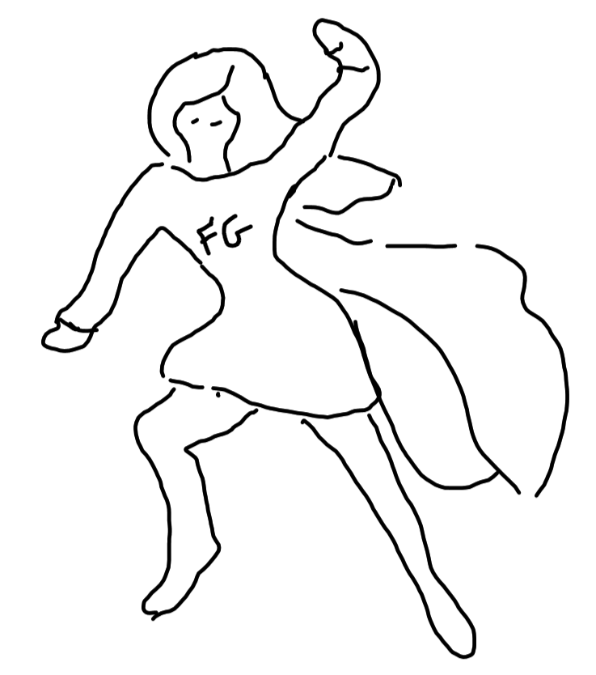
Using Factors for LCM
Find the LCM of 4, 8, 9, and 12 using factors.
1. Factor each number.
4
2
2
9
3
3
8
2
2
2
4
12
3
2
2
4
2. Cancel out common factors: Start with the largest number. Look at the prime factors. If another number has the same prime factor, circle the factor of the largest number and cross out duplicates from the other factor trees. Look at the other prime factors of the number. Circle and cross out like before. Check to see if the smaller numbers still have common factors. Circle and cross out these common factors. Then list the prime factors that were circled and the prime factors that were not crossed out.
3. Multiply the circled and not crossed out factors.
___________________= _____
LCM= _____
Find the LCM of 36, 15, 9, and 4
Notes:
IXL 4 P5,7

Slide 21
Common Denominator
Common Denominator
Make an equivalent fraction to make Denominator 2
To compare fractions use a common denominator
Wisely choose the factor you must.
$$\frac{2}{3}$$
< >
= ?
$$\frac{5}{6}$$
$$\frac{2}{3}$$
$$\frac{}{6}$$
x
=
LCM = x =
Use the LCM (least common multiple) to determine the best common denominator.
Convert the fractions so that they have a common denominator.
$$\frac{2}{8}$$
$$\frac{7}{9}$$
$$\frac{1}{4}$$
=
=
=
$$\frac{2}{6}$$
$$\frac{2}{3}$$
=
$$\frac{8}{9}$$
=
=
$$\frac{2}{3}$$
<
$$\frac{3}{4}$$
Why?
$$\frac{1}{6}$$
$$\frac{1}{4}$$
Why?
Notes:
IXL 4 P5,7

Slide 22
Comparing Fractions
Comparing Fractions
You can use common denominators, a fraction model, or a fraction line to compare fractions.
_________________________________________________________________
$$\frac{1}{6}$$
$$\frac{1}{4}$$
x =
x =
____________________________________________________________
$$\frac{1}{6}$$
$$\frac{1}{4}$$
Why?
___________________________________________________
______________________________________________________________________________________________________
0 1
Compare the fractions.
$$\frac{1}{6}$$
$$\frac{5}{6}$$
$$\frac{11}{16}$$
$$\frac{5}{6}$$
$$\frac{2}{7}$$
$$\frac{1}{5}$$
$$\frac{13}{12}$$
$$\frac{13}{12}$$
One fraction is larger than another when
______________________________________________________________________________________________________________________________________________________________________________________________________________________________________________________________________________________________________________________________________________________________

Slide 23
Review
Review
Draw a model of the fractions.
$$\frac{3}{8}$$
$$\frac{5}{6}$$
Convert the improper fractions to mixed numbers and mixed numbers to improper fractions.
Compare the fractions.
$$\frac{11}{6}$$
=
$$\frac{111}{16}$$
=
$$\frac{11}{6}$$
$$\frac{15}{9}$$
$$\frac{2}{11}$$
$$\frac{1}{10}$$
$$3\frac{11}{16}$$
=
$$7\frac{8}{9}$$
=
Convert the fractions so that they have a common denominator.
$$\frac{2}{8}$$
$$\frac{7}{9}$$
$$\frac{1}{4}$$
=
=
=
$$\frac{2}{6}$$
$$\frac{2}{3}$$
=
$$\frac{8}{9}$$
=
=
Create a fraction line that shows 3rds, 6ths, and 8ths.
Notes:
IXL 6th I6-8

Slide 24
Fractions on number line
Fractions on a number line
We created fractions lines by marking equal shares on a line segment. We can mark fractions on a number line by marking equal shares in between the whole numbers.
To place 13/8^{ths}, first convert it to a mixed number. 1 and 5/8^{ths}
1 and 5/8^{ths} is between 1 and 2 so mark 8 equal shares between 1 and 2.
Mark the fifth eighth.
Mark these fractions on the number line
$$\frac{21}{8}$$
$$\frac{21}{5}$$
$$\frac{9}{4}$$
$$\frac{13}{3}$$
$$\frac{19}{4}$$
$$\frac{21}{24}$$

Slide 25
Fractions on number line
Fractions on a number line
We created fractions lines by marking equal shares on a line segment. We can mark fractions on a number line by marking equal shares in between the whole numbers.
To place 13/8^{ths}, first convert it to a mixed number. 1 and 5/8^{ths}
1 and 5/8^{ths} is between 1 and 2 so mark 8 equal shares between 1 and 2.
Mark the fifth eighth.
Mark these fractions on the number line
$$\frac{21}{8}$$
$$\frac{21}{5}$$
$$\frac{9}{4}$$
$$\frac{13}{3}$$
$$\frac{19}{4}$$
$$\frac{21}{24}$$
But what if your denominator is larger? How do you place 5/24^{ths}?
5/24^{ths} is between 4/24^{ths}? and 6/24^{ths}.
When we reduce these fractions we know approximately where 5/24^{ths} is placed.
Mark these fractions on the number line
$$\frac{19}{15}$$
$$\frac{9}{14}$$
$$\frac{13}{15}$$
$$\frac{19}{32}$$

Slide 26
GCF
Greatest Common Factor
Like the LCM, the Greatest Common Factor (GCF) helps us compute with fractions. The GCF is the largest number that goes into 2 or more numbers.
Factors of 14
1, 2, 7, and 14
Factors of 35
1, 5, 7, and 35
GCF of 14 and 35 is 7.
Factors of 42
1, 2, 3, 6,7, 14, 21 and 42
Factors of 55
1, 5, 11, and 55
GCF of 42 and 55 is 1.
The GCF of all 4 numbers is 1.
GCF – Greatest Common Factor
The GCF of 14 and 28 is 14.
Prime factorization can help you find common factors.
18
3
2
3
6
24
3
2
2
8
2
The GCF of 18 and 24 is ___.
Find the GCF of 18 and 48.
Find the GCF of 24 and 48.
Notes:
Bibi Russell Bangladesh Designer – pays attention to weaving – looks at the parts

Slide 27
Reducing Fractions
Reducing Fractions
$$\frac{2}{3}$$
$$\frac{2}{2}$$
$$\frac{4}{6}$$
$$\frac{4}{6}$$
$$\frac{4÷2}{6÷2}$$
$$\frac{2}{3}$$
x
=
=
=
Reduced Fraction
To the numerator you must.
What you do to the denominator,
Use the GCF
Reduce the fractions.
$$\frac{21}{24}$$
$$\frac{75}{6}$$
$$\frac{42}{65}$$
$$\frac{27}{72}$$
$$\frac{32}{94}$$
$$\frac{25}{125}$$
Notes:
IXL 6th I 4
Bibi Russell Bangladesh Designer – pays attention to weaving – looks at the parts

Slide 28
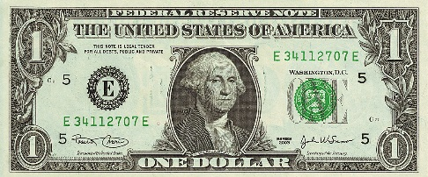
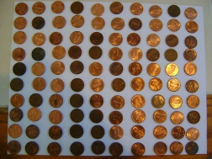
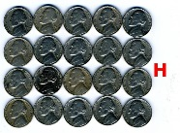
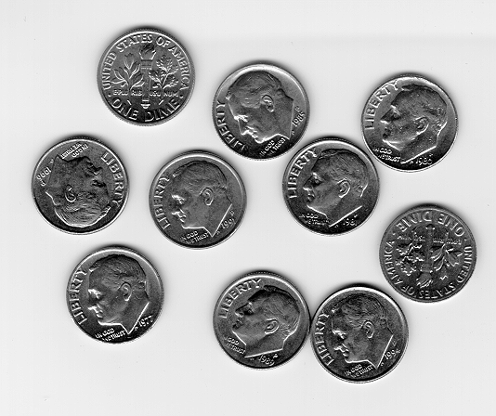
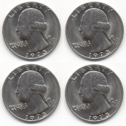
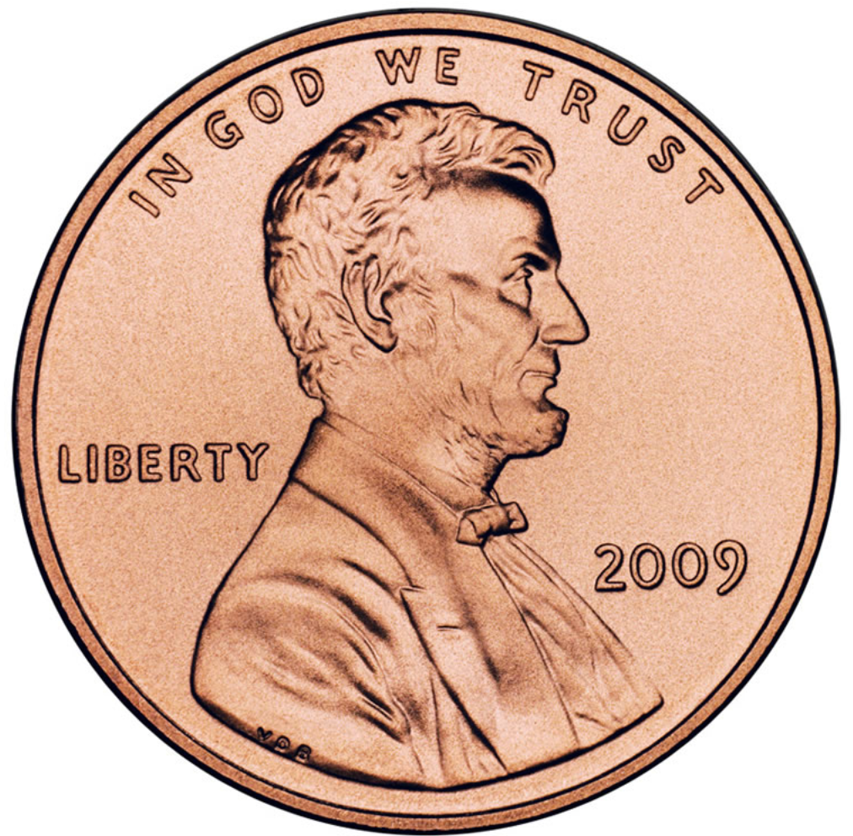
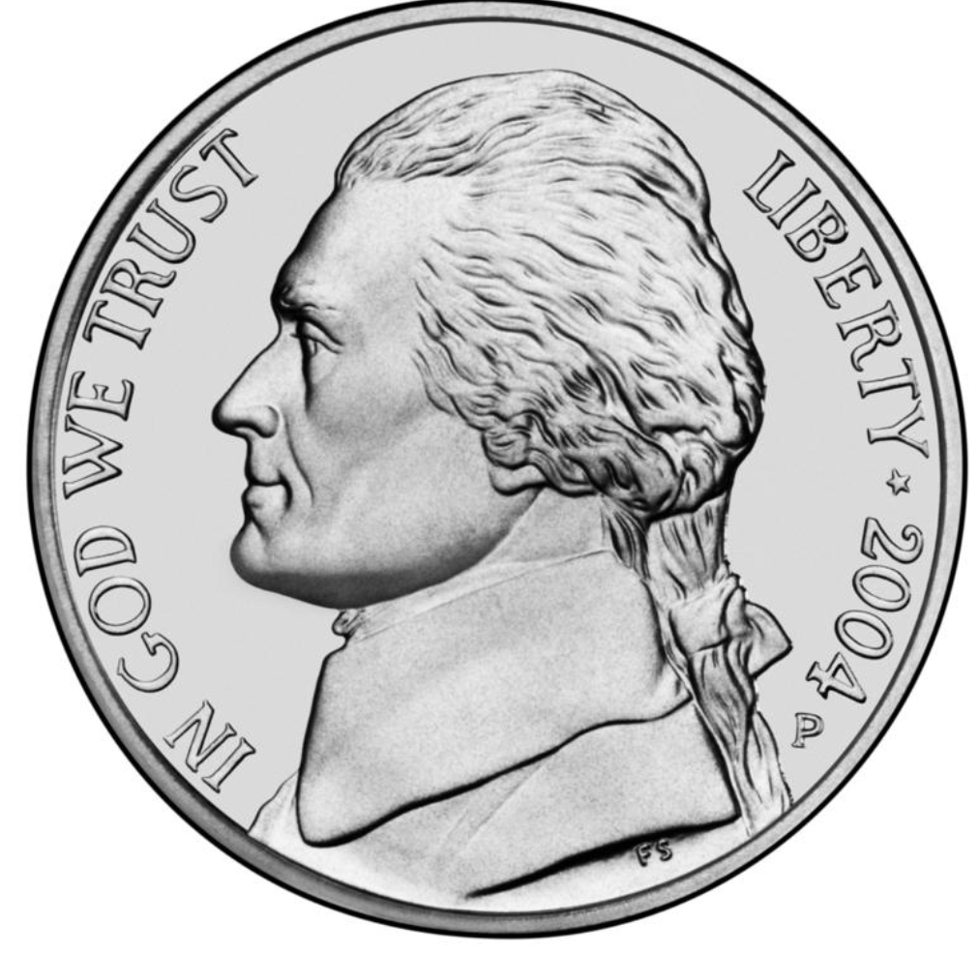
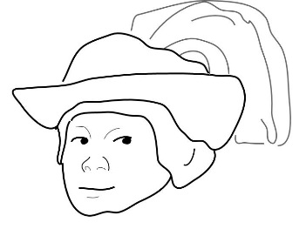
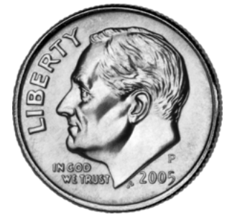
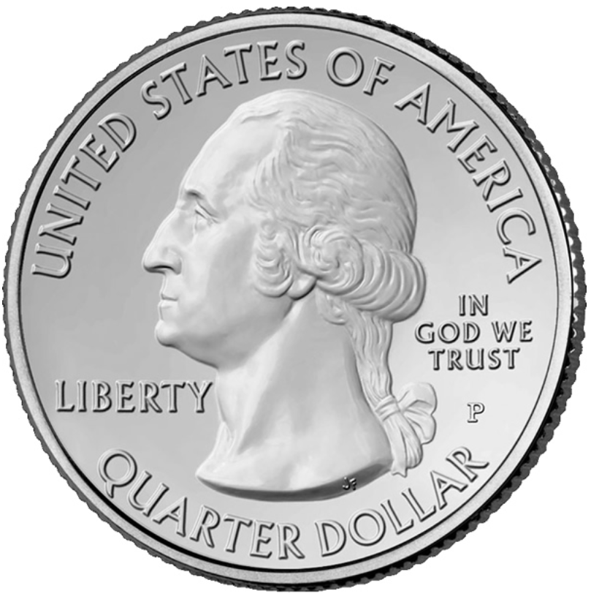
Coin Fractions
Coins are fractions?
http://jcruz661.wikispaces.com/money+-+coins+and+dollars
This Photo by Unknown Author is licensed under CC BY-SA
$1 = 100 pennies = 20 nickels = 10 dimes = 4 quarters
1 penny = $\frac{1}{100}$ 1 nickel = $\frac{5}{100}$ = $\frac{1}{20}$
1 dime = $\frac{10}{100}$ = $\frac{1}{10}$ 1 quarter = $\frac{25}{100}$ = $\frac{1}{4}$
= 75 cents
$\frac{25}{100}+\frac{25}{100}$ + $\frac{25}{100}$ = $\frac{75}{100}$
But a quarter also equals $\frac{1}{4}$so does $\frac{1}{4}$+ $\frac{1}{4}$+ $\frac{1}{4}$= $\frac{75}{100}$ ?
Yes it does because $\frac{1}{4}$ + $\frac{1}{4}$ + $\frac{1}{4}$ = $\frac{3}{4}$ and $\frac{3 x 25}{4 x 25}$ = $\frac{75}{100}$ .
= 13 cents = $\frac{13}{100}$
How does $\frac{1}{100}$ + $\frac{1}{100}$ + $\frac{1}{100}$ + $\frac{1}{10}$ = $\frac{13}{100}$ ?
$\frac{1}{100}$ + $\frac{1}{100}$ + $\frac{1}{100}$ + $\frac{1x10}{10x10}$
Algorithm
___________________________________________________________________________________________________________________________
Notes:
Madam CJ Walker

Slide 29
Adding Fractions
Adding Fractions
Just like adding coins, adding fractions requires a common denominator.
One of those things called thirds plus another of those things called thirds equals 2 of those things called thirds – thirds is just like a label (inches, minutes, cats….)
$$\frac{1}{3}+\frac{1}{3}=\frac{2}{3}$$
$$\frac{1}{5}+\frac{3}{5}=\frac{}{5}$$
$$\frac{1}{8}+\frac{5}{8}=\frac{}{8}$$
$$\frac{11}{13}+\frac{1}{13}=\frac{}{}$$
$$=\frac{}{}$$
Algorithm
You are not done yet!!
_______________________________________________________________________________________________________________________
$$\frac{1}{8}+\frac{3}{8}=\frac{}{}$$
$$=\frac{}{}$$
$$\frac{5}{12}+\frac{1}{12}=\frac{}{}=\frac{}{}$$
$$\frac{5}{12}+\frac{3}{12}=\frac{}{}=\frac{}{}$$
What is the mixed number version of your answer?
_________
$$\frac{5}{16}+\frac{13}{16}=\frac{}{}=\frac{}{}$$

Slide 30
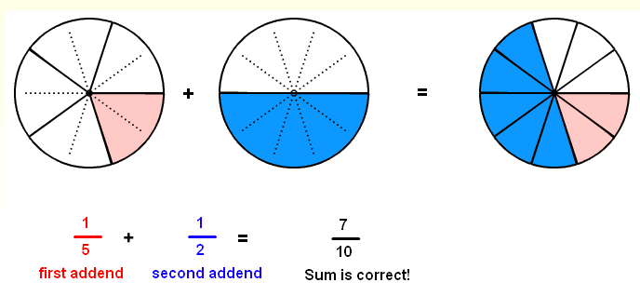
Adding Fractions
Adding Fractions
What if the denominators are not the same?
Algorithm
_______________________________________________________________________________________________________________________
https://www.visualfractions.com/AddUnlikeCircle/addunlikecircle.html
$\frac{1}{3}+\frac{1}{5}=\frac{}{}$ + =
$\frac{4}{15}+\frac{2}{5}=\frac{}{}$ + =
$\frac{5}{12}+\frac{3}{8}=\frac{}{}$ + =
Adding Mixed Numbers
$$2\frac{3}{4}+5\frac{4}{5}$$
$$\frac{11}{4}+\frac{29}{5}$$
Improper fraction
$$2+5+\frac{3}{4}+\frac{4}{5}$$
Rearrange
$$\frac{55}{20}+\frac{116}{20}$$
Common denominator
$$2+5+\frac{15}{20}+\frac{16}{20}$$
Common denominator
$$\frac{171}{20}$$
Add
$$7+\frac{31}{20}$$
Add
$$8\frac{11}{20}$$
Mixed number
reduce if necessary
$$7+1\frac{11}{20}$$
Mixed number
Add
$$8\frac{11}{20}$$

Slide 31
Subtracting Fractions
Subtracting Fractions (with negatives)
$\frac{1}{3}−\frac{1}{5}=\frac{}{}$ $−$ =
Yes, you can have negative fractions. Follow the same rules as integers once you have a common denominator.
$\frac{1}{3}−\frac{4}{5}=\frac{5}{15}$ $−$ $\frac{12}{15}$
$$\left|−\frac{12}{15}\right|>\left|+\frac{5}{15}\right|$$
$\frac{12}{15}$ $−$ $\frac{5}{15}$ = $\frac{7}{15}$
$\frac{5}{15}$ $−$ $\frac{12}{15}$ = - $\frac{7}{15}$
Subtract the lesser absolute value from the greater absolute value.
Keep the sign from the original with the greater absolute value.
subtracting Mixed Numbers
$$5\frac{3}{4}−2\frac{4}{5}$$
$$\frac{23}{4}−\frac{14}{5}$$
Improper fraction
$$5\frac{15}{20}−2\frac{16}{20}$$
Common denominator
$$\frac{115}{20}−\frac{56}{20}$$
Common denominator
$$4\frac{35}{20}−2\frac{16}{20}$$
Regroup since 16/20 > 15/20
$$\frac{59}{20}$$
Subtract
Take one whole from 5 to get 4 and 20/20ths.
Add 20/20ths to 15/20ths
$$2\frac{19}{20}$$
Mixed number
reduce if necessary
$$2\frac{19}{20}$$
Subtract

Slide 32
Multiply a whole # by fraction
Multiplying a Whole Number by a Fraction
Multiplying by fractions is just making equal shares and choosing part.
$$8×\frac{1}{4}$$
Chop it up in to 4 equal shares.
Choose 1 from each group you must.
Just like sharing cookies – the denominator represents how many friends ypu are sharing with.
$8×\frac{1}{4}$ = $\frac{8}{4}$ = 2
Simplify!
$$8×\frac{3}{4}$$
Chop it up in to 4 equal shares.
Choose 3 from each group you must.
My brother always said 3 cookies for him and 1 for me was fair because he was older.
$8×\frac{3}{4}$ = $\frac{24}{4}$ = 6
8 groups of 3 (of those things called 4ths)
Algorithm
Multiply the whole number by the numerator and keep the denominator. Then simplify.
3 × $\frac{5}{8}$ =
4 × $\frac{5}{4}$ = =
1 9
9 × $\frac{5}{18}$ =
4 × $\frac{5}{2}$ = =
9 × $\frac{7}{12}$ = =
2 9
Notes:
IXL 6 k2

Slide 33
Multiply Fraction by Fraction
Multiplying a Fraction by a Fraction
$$\frac{2}{3} × \frac{3}{4}$$
$$\frac{3}{4}$$
$$\frac{2}{3}$$
Multiply the numerators for the new numerator and multiply the denominators for the new denominator. Then simplify.
OR
Use common factors to reduce then multiply across.
Algorithm
Simplify!
$$\frac{1}{4} × \frac{1}{4}=$$
$$\frac{1}{6} × \frac{3}{4}= =$$
$$\frac{2}{9} × \frac{3}{4}= =$$
1 9
1 5
$\frac{9}{15}$ × $\frac{5}{18}$ =
$$\frac{1}{6} ×\frac{3}{ 4}=$$
$$\frac{2}{9} × \frac{6}{4}=$$
3 5
2 9
Notes:
K 5-8 (5 and 8 optional)

Slide 34
Dividing Fractions
Dividing by a Fraction
$$8÷\frac{1}{4}$$
How many one-fourths in 8?
$8÷\frac{1}{4}$ = 32
$$3÷\frac{1}{3}=$$
$$7÷\frac{1}{9}$$
$$10÷\frac{1}{2}$$
Reciprocal – multiplicative inverse – a number times its reciprocal always equals 1
$$3×\frac{1}{3}=1$$
$$\frac{1}{3}×3=1$$
$$\frac{7}{4}×\frac{4}{7}=1$$
$$7÷\frac{1}{9}=7×9=63$$
Since
,
what does the reciprocal have to do with dividing fractions?
To divide by a fraction, multiply by the reciprocal.
what does the reciprocal have to do with dividing by fractions?
________________________________________________________________________________________________________
$$7÷\frac{1}{5}$$
=
$$8÷\frac{1}{6}$$
=
$$\frac{1}{5}÷\frac{5}{6}$$
=

Slide 35
Multiply Divide Mixed Numbers
Multiplying or Dividing Mixed Numbers
Convert the mixed numbers into improper fractions then multiply or divide. Write in simplest form.
Algorithm
$$3\frac{2}{5} ×2\frac{1}{4}=$$
Convert the mixed numbers into improper fractions.
$$\frac{17}{5} ×\frac{9}{ 4}= \frac{153}{20}$$
Multiply.
Convert back to a mixed number if required
$$\frac{153}{20}=7\frac{13}{20}$$
$$3\frac{1}{4} × 2\frac{1}{4}=$$
$$5\frac{1}{6} × 2\frac{3}{4}=$$
$$2\frac{2}{9} × 6 \frac{3}{4}=$$
$$3\frac{1}{4} ÷ 2\frac{1}{4}=$$
$$5\frac{1}{6} ÷ 2\frac{3}{4}=$$
$$2\frac{2}{9} ÷ 6 \frac{3}{4}=$$
Notes:
IXL Grade 6 K 5-8 (5 and 8 optional)

Slide 36
Presentation Data
Part of whole – Numerator Denominator (Arnold Swartzinagor) Equal shares – more shares smaller parts
Part of group using part of whole format – creating equal groups
Mixed Numbers
Order / size
Adding Common Denominator
Creating common denominator
Base 10 fractions
Adding Different Denominator
Multiplying Fractions – breaking first fraction into same parts as 2nd fractions – array/overlay
Divide Fractions – how many __ in original – break in denominator part (multiply by denominator) group by numerator (how many of those) start w ½ 1/x then do dif numerators

Slide 37
Presentation Data
Decimals as part of 10^x
Decimal to fraction
Fraction to decimal
Percent as %/100
Percent to Decimal
Decimal to percent
Fraction to percent
Rational Numbers
Order rational numbers
Story problems / applications

Slide 38
Fractions – part of the whole
Parts must all be the same size – equal shares
Share it equally, Baby.
Make 3 equal parts
Make 4 equal parts
Make 3 equal parts

Slide 39
Fractions – part of the whole
Parts must all be the same size – equal shares
Unequal are Terminated.
Cross out the shapes with unequal shares.

Slide 40
Fractions – part of the whole
Parts must all be the same size – equal shares
Choose wisely you must.
Choose 5.
$$\frac{5}{8}$$
$$\frac{2}{3}$$
Choose 2
Choose 1
$$\frac{3}{4}$$
$$\frac{1}{2}$$
Choose 3
$$\frac{5}{12}$$
Choose 2
$$\frac{2}{4}$$
Choose 5.
Choose 7
$$\frac{7}{8}$$

Slide 41
Fractions – part of the whole
Numerator – how many chose you did
How many shares you chose
Parts we have
Numerator
Division bar or fraction bar
Denominator
Total parts
Denominator – how many equal chares
Named with ordinal numbers
Ordinal Numbers – half, third, forth or quarter, fifth…
List 5 more ordinal numbers __________________
__________________________________________

Slide 42
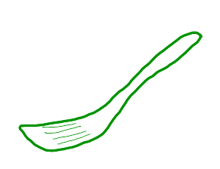
Cast of Characters
Numerator am I. Group wisely you must.
I’m the Denominator. I’ll be back.
Whole Cooke!
Learning decimals will help you with the petty cash.
Notes:
Yoda – numerator, Terminator – denominator, Cookie Monster – whole and mixed numbers, Uncle Scrooge McDuck – decimals through money, Einstein – challenge, pre-introduction of concept, having fun with math

