Slide 1
Integers
definition • uses • number line
absolute value • comparing • operations on integers
adding • subtracting • multiplying and dividing • exponents

Slide 2
Integers
Numeral The symbol we write
Number The concept of a specific quantity
Positive and negative whole numbers
Numbers that can be written without fractions or decimals.
…-5, -4, -3, -2, -1, 0, 1, 2, 3, 4, 5…
Does not include mixed numbers (positive or negative numbers with fractions or decimals), numbers between 0 and 1, and numbers between -1 and 0.
-½ and .777 and -4¾ and 5.342 are not integers.
211
99
-1
Whole Numbers
0
7,000,000
1
-5
-83
2
Integers – positive and negative whole numbers
-205942
-991
Whole Numbers 0 and the numbers we use for counting.
Integers positive and negative whole numbers
Integers that have a value greater than 0 are positive and can be written with or without a + sign before the numeral.
+7 is the same value as 7.
Integers that have a value less than 0 are negative and have a – sign before the numeral. Sometimes mathematicians use parenthesis ( ) to emphasize that the number is negative. – 3 is the same value as (-3)
Positive A value greater than 0
Negative A value less than than 0
Mixed Numbers positive or negative numbers written with both a whole number and a fraction or decimal
Parenthesis ( ) used to:
separate a numeral for clarity
show multiplication
group numerals or expressions
Notes:
Positive integers are integers greater than _____.
________________ integers are integers less than zero.
Circle the positive integers:
-3 27 10,000 -9,999,999 99 -87 (-78) -47` 39 1 -24
Circle the negative integers:
-888 -90 (55) 345 1,000,000,000 -987,654,321 (-2) -333 8,700
Cross out all the numbers that are not integers:
3.14 -6.33 7 -29 (½) -7¾ .12121 -121212 12121 -9,999,999
Why is the number -1.618 not an integer?
When have you used integers? Give several examples.
Name #

Slide 3
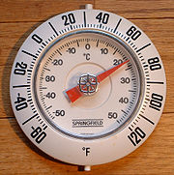
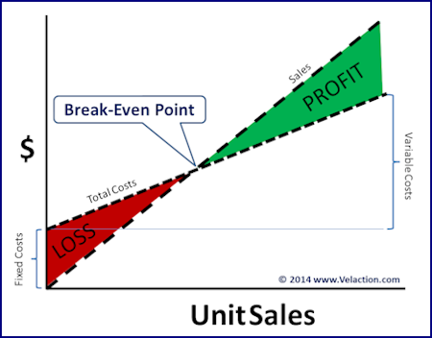
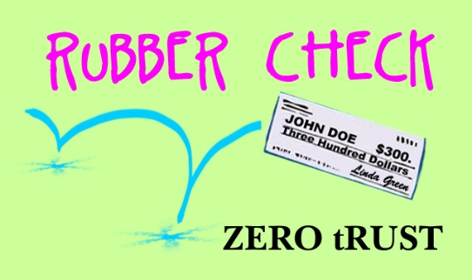
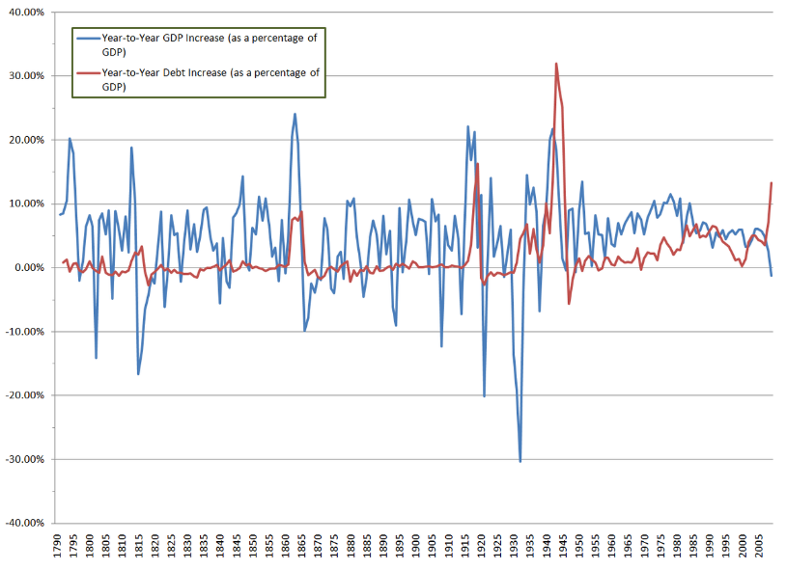
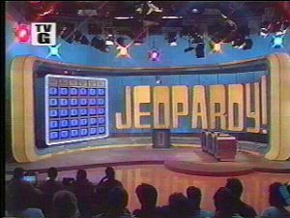
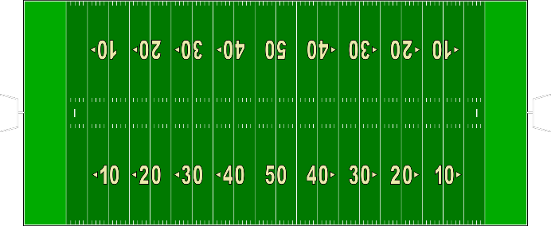
Useful Integers
Integers are used in many daily activities.
Land that is below sea level is measured as a negative elevation.
A negative increase is the same as a decrease.
In the red
If you get a negative number when you subtract your cost from your sales, you had a loss.
increase of -10%
is the same as a 10 % decrease.
Loss of yards
Images from creative commons.
Notes:
Negative profits mean the company lost money. Cross out all the losses.
$50 -$100,000 $3,400,000 $5 -$6,766,090,987 -$33 $900
Circle all the elevations that are below sea level.
Deep Lake, Antarctica -50m Helena, MT 3,875' Thermal, CA -121 ft
Pikes Peak 14,115' Amsterdam -7 feet Dead Sea -430 meters
Write the change in yards as an integer. A gain of yards is a positive integer. A loss of yards is a negative integer.
Loss of 40 yards = _______ yards
Gain of 2 yards = _______ yards
Gain of 5 yard = _______ yards
Loss of 3 yards = _______ yards
Write the temperature using integers.
Minus 30 = ______ degrees
5 below zero = ______ degrees
Positive 19 = ______ degrees
Three students left the class, write the integer that shows how the class size changed.
Name #

Slide 4
Integers
Negative Integers go to negative infinity
Negative Integers
Positive Integers
Positive Integers go to positive infinity
Zero
(Origin)
…
…
Values decrease
Values increase
All the spaces in-between the positive or negative whole numbers represent non-integers.
When the number line has a zero and increases by exactly 1 and decreases by exactly 1 between each number, the spaces in between the numbers represent non-integers. If the numbers on the number line increase and decrease by a value more than 1, the space in-between the numbers will include integers.
Numbers that can be written without fractions or decimals are integers.
12.000 = 12 so 12.000 is an integer. 2/2 = 1 so 2/2 is an integer.
12½ =12.5 It cannot be written without a decimal or fraction so it is not an integer.
Positive Integer
an integer greater than 0
Origin
The location that separates positive and negative values on a number line or plane.
Infinity ∞
the concept of numbers that cannot be counted – it is always more (or less for negative infinity) than the highest (or lowest) number, a value without limit
Negative Integer
an integer less than 0
Notes:
Vocabulary Review - Write a definition and when possible write the symbol and/or give an example
Whole number
Mixed number
Parenthesis
Integer
Numeral
Number
Positive Integer
Negative Integer
Origin
Infinity
Name #

Slide 5
Plotting Integers Horizontal
We can represent values on a number line by plotting points. Plotting a point means to put a mark at the location of the desired value.
Negative values are plotted to the left of zero and positive values are plotted to the right of zero.
To plot -5 we put a dot above the -5 on the number line. We can label that point by writing a capital letter near the dot. We label the plot so that we can refer to the location and value easily.
P
R
Negative Integers
Zero
(Origin)
Positive Integers
The values -5 and 3 are plotted. They are labeled P and R. We can say that P is to the left of R. R is to the right of the origin. P is negative. R is positive.
Horizontal
Left to right – along the horizon – sideways
Plot
To mark a location on a number line or plain
Plot Point
The marked (plotted) location
Label
A letter or name used to designate a plot point or object
Notes:
Plot and label the integers.
A = 4 C = 0 D= (-8) E = -7 R = 5 S = -3 T = 7
List the labels in order from least to greatest (left to right on the number line) to find the name of a mathematician that expanded on the concept of a number line.
___ ___ ___ ___ ___ ___ ___ e s (1596-1650)
Name #
Descartes is pronounced "Day Cart". He developed many concepts that later became calculus.
Vocabulary Review - Write a definition and when possible write the symbol and/or give an example.
Parenthesis
Integer
Numeral

Slide 6
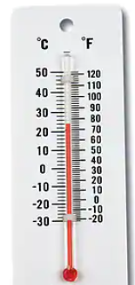
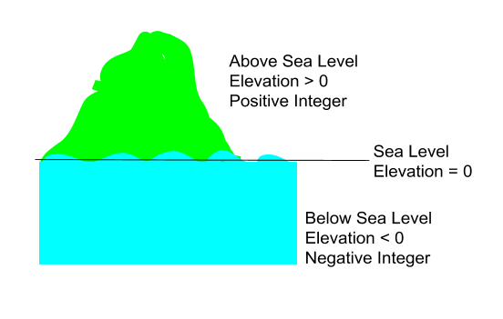
Plotting Integers Vertical
Number lines can be vertical (up and down) as well as horizontal (left to right). Temperature and elevation (height) are often shown with a vertical number line.
Negative values are plotted below zero and positive values are plotted above zero.
Positive Integers
R = 3
R
Zero
(Origin)
P = -5
P
Negative Integers
Vertical
Up and Down
Elevation
height above or below a fixed reference point
> Greater than - above
< Less than - below
Thermometer Image from Quill (Learning Advantage) – Creative Commons
Notes:
Plot and label the integers.
A = 3 B = 10 C = -2 N= (-7)
List the labels in order from greatest to least (top to bottom on the number line) to find the name of a mathematician that often used integers.
___ ___ ___ O ___ - Bercey (1928-2019)
What other scientific fields would use integers?
Give a few examples of negative integers used in science.
Name #
June Bacon-Bercy was the first African-American woman to earn a degree in meteorology in the United States. .

Slide 7
Absolute Value
F
L
R
D
A
Values decrease
Values increase
The absolute value of a number is the value of the distance of the number from zero. Absolute value is always positive. We show absolute value using bars like this|-3| or we can write abs(-3).
|9| = 9 because 9 has a distance of 9 from 0. |A| = 9 because A is at the value 9.
|-9| = 9 because -9 has a distance of 9 from 0. |F| = 9 because F is at the value -9.
|A| = |F|. Both plot points are the same distance from 0.
|R| = |0| = 0 because it is 0 distance away from 0. |L| = |-5| = 5 |D|=|4| = 4
We use absolute value in daily life.
Money is almost always referred to using the absolute value. We say, "The balance on my credit card is $220." even though we know we have to pay $220 which makes the $220 negative.
Absolute value is always used to show magnitude – how strong a force is.
Distance is also measured using the absolute value. Even if you are moving away, the distance is positive.
Notes:
Plot points A = -3, F = -7, S =0, T = 3
Write the absolute value:
|F| = |-7| = 7 |A| = |S| = |T| =
|-21| = |91| = |-3,333| =
Name #
Vocabulary Review - Write a definition and when possible write the symbol and/or give an example
Whole number
Mixed number
Negative Integer
Infinity

Slide 8
More Vocabulary
Constant
A number that does not
change its value
Variable
A number represented by a letter or symbol with an unknown or changing value
Operation
A mathematical process such as addition, subtraction, multiplication, division, absolute value, square root…
Equation
A statement that shows 2 expressions are equal – written in the form
expression = expression. Ex: x = 4 + y
multiplication
division
Expression
A term or terms joined by + or -
3•4 + 2x – 7/c + 201
Inequality
A statement that 2 terms are not always equal – written in the form
expression > expression
or expression < expression
Ex: x < 4 + y
Can also include $≤or ≥.$
Coefficient
A constant that multiplies a variable.
Equal To =
having the same value
Term
Number, variable, or both (joined by multiplication or division); often separated by + or – or < or > or =
Less Than <
having a lower value
Greater Than >
having a higher value
Notes:
Name #
How are constants and variables different?
How can you remember which way the greater than and less than signs are written?
What is the relationship between an equation and expressions?
How can you tell how many terms are in an expression?
What is a coefficient?
List the symbols for at least 4 operations.

Slide 9
Comparing Integers
F
L
R
D
A
Values decrease
Values increase
We can compare values of plot points on a number line. Plot points that are to the left of other points have a lower value and are less than points to the right. Plot points to the right have higher values and are greater than points to the left.
F < L D > R A > 4 L < 0 L = -5 (-9) < 0 0 = R A = 9 R > -5 F < D 9 > L
L < D < A 4 > -5 > F
We can compare the integers without using a number line.
Positive integers are always greater than negative integers. 6 > (-3) 2 > -10,000
Negative integers are always less than positive integers. -5 < 5 -1010 < 1010
When all integers are positive, the larger numbers are always greater. 5 < 10 110 > 101
Negative integers are a little weird though. The greater the absolute value of the negative integer, the "more negative" the integer so a greater absolute value (distance from zero) makes the integer less than the other negative integer.
-4 > -12 because |-4| = 4 and |-12| = 12 so -12 is "more negative" or further from zero on the negative side.
-100 < -90 because |-100| is 100 and |-90| = 90 100 > 90 so -100 is further from 0 making it less than -90.
(L is less than D which is less than A)
(4 is greater than -5 which is greater than F)
Notes:
Complete the expression. Use < or > or =
-5 ____ 5
100 _____ 10
-25 ____ 0
1,000 _____-9
23 _____ 32
-23 _____ -32
-798 _____ -798
43 _____ -34
2 _____ 0
-100 _____ 10
Name #
Be careful with the absolute value!
|-5| ____ 5
|100| _____ 10
|-25| ____ 0
|1,000| _____-9
|-32| _____ |32|
-23 _____ |-32|
-798 _____ |-798|
|43| _____ |-34|
|2| _____ 0
-100 _____ |10|

Slide 10
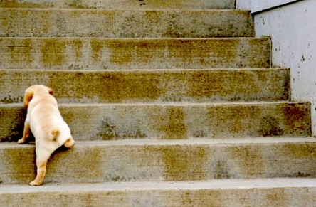
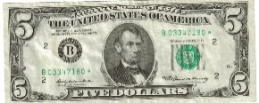
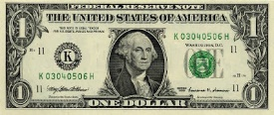
Operations with Integers
Operation
A mathematical process such as addition, subtraction, multiplication, division, absolute value, square root…
There are special considerations when computing with integers. The same way we can't make a negative balance on our bank account disappear just by wishing it, we can't get rid of a negative by ignoring it.
We have to consider the view point – if I am on the roof of a 3 story building, I am looking down about 40 feet (-40 feet). A person looking up to me would have to look up 35 feet (+35). A bill I owe is a negative for me and a positive for the company. Making a payment is a negative for your bank account but a positive for the credit account.
3 steps 7 inches high to reach the bone
3 • 7 inches = +21 inches
Cost $1
Or -$1 from your wallet
-$3 from your wallet
3 • (-1) = -3
+
=
This diver can descend (swim down) 20 meters (-20) per minute. How many minutes will it take to descend 40 (-40) meters?
-40 / -20 = 2 minutes
$5 + (-$3) = $2
4 steps 7" high to the bottom
4 • -7 inches = -28"
You owe me $1
+
=
$5 + (-$6) = -$1
Notes:
Match the expression to the situation.
Dropping a hook 35 feet from your boat 3 feet above the water. ___
Buying 3 $35 shirts from your wallet's perspective. ___
Buying 3 $35 shirts from cash register's perspective. ___
Removing 3 leaves 35 times from the tree's perspective. ___
Diving 7 more feet from a depth of 98 feet.
If your checking account has $98 and you deposit $7. ___
Cut off 7" from a 98" long thread. ___
How long would it take a lure that drops 7" per second to reach a depth of 98"? ___
Your checking accounts perspective of buying 98 $7 bead packets. ___
Your savings account balance after 98 $7 deposits. ___
Name #
3 •-35
3 • 35
-3 • 35
3 + 35
3 – 35
-3/35
98-7
98/-7
98 + 7
98 • (7)
98 • (-7)
-98/-7
-98 + -7

Slide 11
Adding Integers
Same signs
Move to the right for positive integers
3 + 4 = 7
+4
+7
+3
Start here
Move 4 to the right
-3 + (- 4) = -7
-4
-7
-3
Move to the left for negative integers
Start here
-1 + -8 = -9
1 + 8 = 9
Start negative. Move negative. Stay negative.
Start positive. Move positive. Stay positive.
Notes:
Add the integers. Remember to include the signs. Use the number line even if you don't need it.
Name #
-5 + -4 = _____
-3 + -4 = _____
-1 + -8 = _____
-6 + -1 = _____
5 + 4 = _____
7 + 2 = _____
1 + 6 = _____
3 + 3 = _____

Slide 12
Adding Integers
Commutative Property of Addition
If you have 2 terms joined by addition, you can add the terms in 2 different orders a+b or b+a
Opposite signs
Move to the right for positive integers
- 5 + 7
Start here
+7
-5
- 5 + 7 = 2
Move to the left for negative integers
7 + (- 5)
Start here
+7
-8 + 4 = -4
8 + -4 = +4
-8 + 4 = 4 + -8
8 + -4 = -4 + 8
-6 + 2 = -4
6 + -2 = 4
-6 + 2 = 2 + -6
6 + -2 = -2 + 6
Notes:
Name #
Add the integers. Remember to include the signs. Use the number line even if you don't need it.
-5 + 4 = _____
3 + -4 = _____
1 + -8 = _____
-6 + 1 = _____
5 + -4 = _____
7 + -2 = _____
-1 + 6 = _____
-3 + 9 = _____

Slide 13
Adding Integers
Commutative Property of Addition
If you have 2 terms joined by addition, you can add the terms in 2 different orders a+b or b+a
- 5 + -2 = -7
5 + 2 = 7
- 1 + -8 = -9
75 + 29 = 104
When you add integers with the same sign, what pattern do you notice?
When the signs are the same you add the value of the numerals (the absolute value of the integers) and keep the sign of the integers. The sum is "more positive" or "more negative".
- 5 + 7 = 2 -5 + 3 = -2 9 + -4 = 5
When you add integers with different signs, what pattern do you notice? Ex: -5 + 3 = -2 9 + -4 = 5
When you add integers with different signs, you subtract the smaller value of the numerals (lowest absolute value) from the larger and keep the sign of the numeral with the larger value.
-5 + 7 7 – 5 |-5| < |7| Using the commutative property we change the order to 7 + -5 |7| – |-5|
7 – 5 = 2 because|7| > |-5| we keep the sign of the 7 so -5 + 7 = 2
-5 + 3 |-5| - |3| 5 – 3 = 2 Since |-5|>3 we keep the negative sign. -5 + 3 = -2
Notes:
Name #
Add the integers. Remember to include the signs.
-5 + (-4) = _____
-3 + (-4) = _____
1 + (-8) = _____
-6 + 1 = _____
5 + (-4) = _____
-7 + (-2) = _____
1 + 6 = _____
-3 + 9 = _____
-23 + (-46) = _____
23 + (-46) = _____
23 + 46 = _____
-23 + 46 = _____
-223 + 146 = _____
223 + 146 = _____
-223 + (-146) = _____
223 + (-146) = _____

Slide 14
Subtracting Integers
Subtraction – opposite of addition
Move to the LEFT to subtract positive integers
3 - 4 = -1
If I added 4, I would move to the right; since I am subtracting I do the opposite.
Move 4 to the left.
-1
Start here
3 - (- 4) = 7
Move 4 to the right.
-7
Start here
Move to the RIGHT to subtract negative integers
If I added -4, I would move to the left; since I am subtracting I do the opposite.
-1 - 8 = -9
1 - -8 = 9
This looks like -1 + -8 = -9. Why?
This looks like 1 + 8 = 9. Why?
Notes:
Name #
Subtract the integers. Remember to include the signs. Use the number line!
-5 – (-4) = _____
-3 – (-4) = _____
1 – (-8) = _____
-6 – (-1) = _____
5 - 4 = _____
-7 - 2 = _____
11 - 6 = _____
-3 - 3 = _____

Slide 15
Subtracting Integers
Subtraction – adding the opposite
Using a number line, we saw that -1 – 8 is the same as -1 + -8.
Just as subtraction is moving the opposite direction as adding, subtraction is adding the opposite. We just change -8 (subtract 8) to + -8 (add -8.) Subtracting a positive integer is the same as adding a negative integer.
We saw that 1 – -8 is the same as 1 + 8. We are adding the opposite of -8. Subtracting a negative number is the same as adding a positive number.
Instead of learning new rules for subtraction, we just change subtraction to addition and change the sign. This way we just follow the rules we already know.
25 – 36 25 + -36 +- different signs rule 25 + -36 = -11
-25 – 36 -25 + -36 -- same signs rule -25 + -36 = -61
25 – (-36) 25 + (+36) ++ same signs rule 25 + 36 = 61
-25 – (-36) - -25 + (+36) -+ different signs rule -25 + 36 = 11
Notes:
Name #
Subtract the integers. Remember to include the signs.
-3 – (-4) = _______ 12 – 3 = _______
3 – (-4) = _______ 12 – (-3) = _______
3 - 4 = _______ -12 – 3 = _______
-3 – 4 = _______ -12 – (-3) = _______
-128 – (-130) = _______ 145 – 87 = _______
-543 – 27 = _______ -986 – (-900) = _____
345 – (-456) = _______ -1010 – 1010 = _______
676 – 989 = _______ 989 – 676 = _______
Vocabulary review - write the vocabulary word that matches the definition.
A value less than 0. _________________
The symbol we write to represent a number. Ex: 6. ________________

Slide 16
Multiplying and Dividing Integers
Rules for multiplying and dividing integers:
When multiplying or dividing 2 values, if the signs are the same, the product or quotient is positive.
2•2 = 4 -3•-4 = 12 -27/-3 = 9 48/6 = 8
When multiplying or dividing 2 values, if the signs are different, the product or quotient is negative.
-2•2 = -4 3•-4=-12 -27/3 = -9 48/-6 = -8
When multiplying and/or dividing more than 2 values:
Work left to right, change the sign as the rules dictate.
2•-3•-4•-4 -1•-5•3•7 2•-96/3
2•-3 = -6 -1•-5 = +5 2•-96 = -192
-6 •-4•-4 5•3•7 -192/3 = -64
-6•-4 = +24 5•3=15
24•-4 = -96 15•7=105
Or count the negative integers – an odd number of negative integers means the answer will be negative
2•-3•-4•-4 3 negative integers means a negative answer
-1•-5•3•7 2 negative integers means a positive answer
2•-96/3 1 negative integer means a negative answer
Notes:
Name #
Multiply or divide the integers. Remember to include the signs.
-3 • (-4) = _______ 12 / 3 = _______
3 • (-4) = _______ 12 / -3 = _______
3 • 4 = _______ -12 / 3 = _______
-3 • 4 = _______ -12 / (-3) = _______
-128 • -130 = _______ 145 • 87 = _______
-543 • 2 = _______ -900 / (-900) = _____
345 / (-5) = _______ -10 • 1010 = _______
-72 / -9 = _______ 264 / 66 = _______
Vocabulary review - write the vocabulary word or symbol that matches the definition.
The value of the distance a number is from 0. _________________
The symbol we write to represent infinity. _______

Slide 17
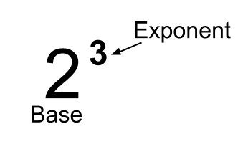
Integers with Exponents
Exponents tell us to multiply the base number a set number of times. 2³ means 2•2•2 so 2³ = 8.
When the base is positive, the value will be positive.
When the base is negative, the value can be either positive or negative.
The value is positive when the exponent is even.
The value is negative when the exponent is odd.
-2³ = -2•-2•-2 -2⁴ = -2•-2•-2•-2
= +4 • -2 = +4 • +4
= -8 = +16
3 is odd so the value is negative.
4 is even so the value is positive.
Notes:
Determine the value.
3² = _______ 10² = _______
-3² = _______ -10² = _______
3³ = _______ 10³ = _______
-3³ = _______ -10³ = _______
3⁴ = _______ 10⁴ = _______
-3⁴ = _______ -10⁴ = _______
3⁵ = _______ 10⁵ = _______
-3⁵ = _______ -10⁵ = _______
-1¹ = ___ -1² = ___ -1³ = ___
-1⁴ = ___ -1⁵ = ___ -1⁶ = ___
Name #

